Slide 1

Malignant Comments Classifier
Guided By:
Swati Mahaseth
Presented By:
Neeraj Kumar S

Slide 2
INTRODUCTION
• The proliferation of social media enables people to express their opinions widely online. However, at the same time, this has resulted in the emergence of conflict and hate, making online environments uninviting for users. Although researchers have found that hate is a problem across multiple platforms, there is a lack of models for online hate detection.
• Online hate, described as abusive language, aggression, cyberbullying, hatefulness and many others has been identified as a major threat on online social media platforms. Social media platforms are the most prominent grounds for such toxic behavior.
• Our goal is to build a prototype of online hate and abuse comment classifier which can used to classify hate and offensive comments so that it can be controlled and restricted from spreading hatred and cyberbullying.

Slide 3
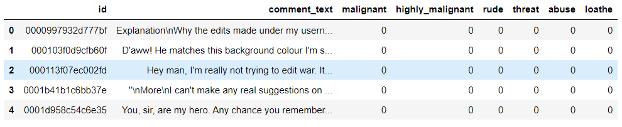
DATA PREPRATION
With the help of Pandas Library We will upload our data to Jupyter Notebook.
Once our data is uploaded with the help of predefined method (i.e. read_csv) we can read data for further processing.
We have two type of variables in the data:-
Dependent Variable
Independent Variable

Slide 4
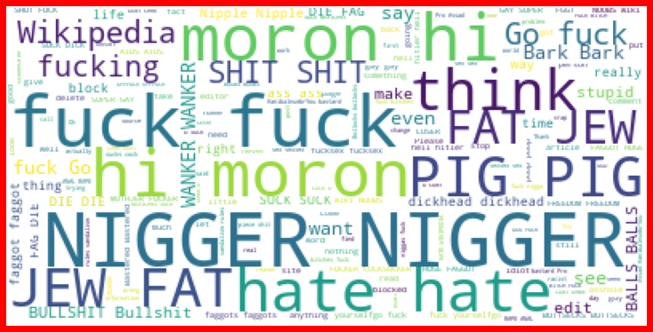
Malignant

Slide 5
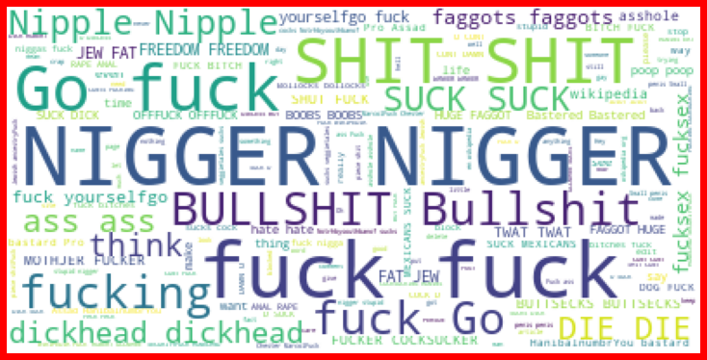
Rude

Slide 6
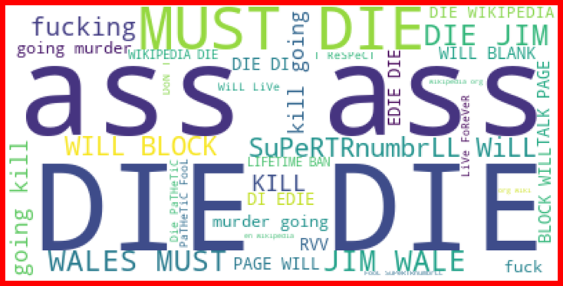
Treat

Slide 7
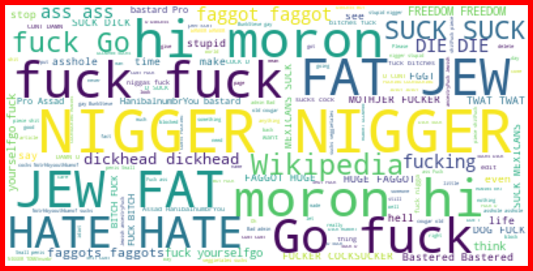
Abuse

Slide 8
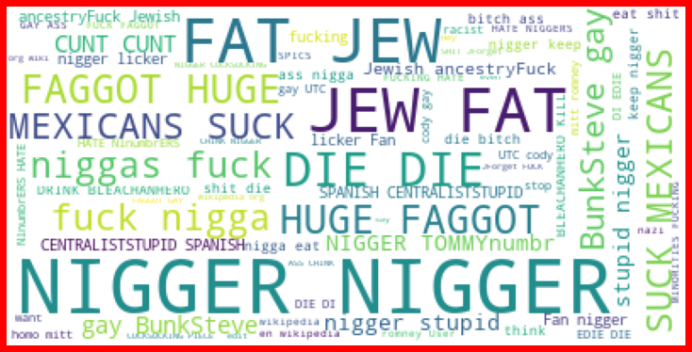
Loathe

Slide 9
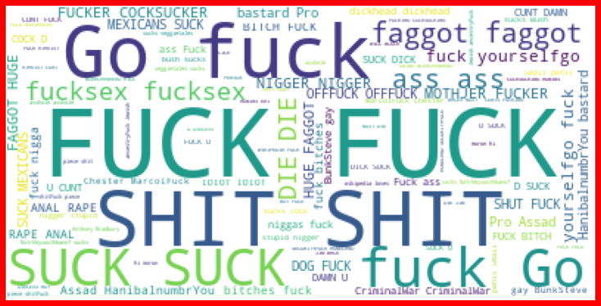
Highly_Malignant

Slide 10
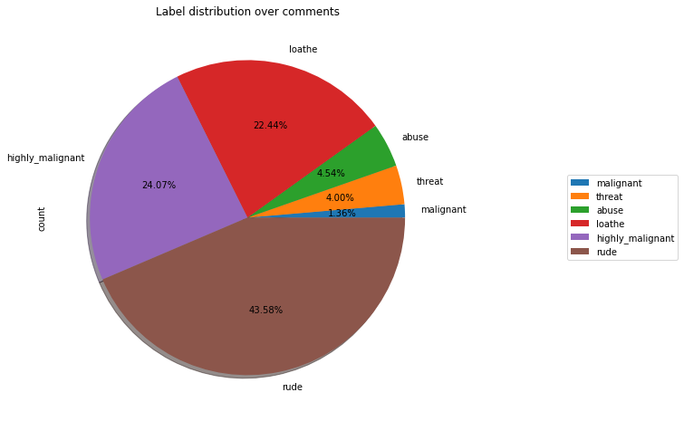
Label Distribution over Comments

Slide 11
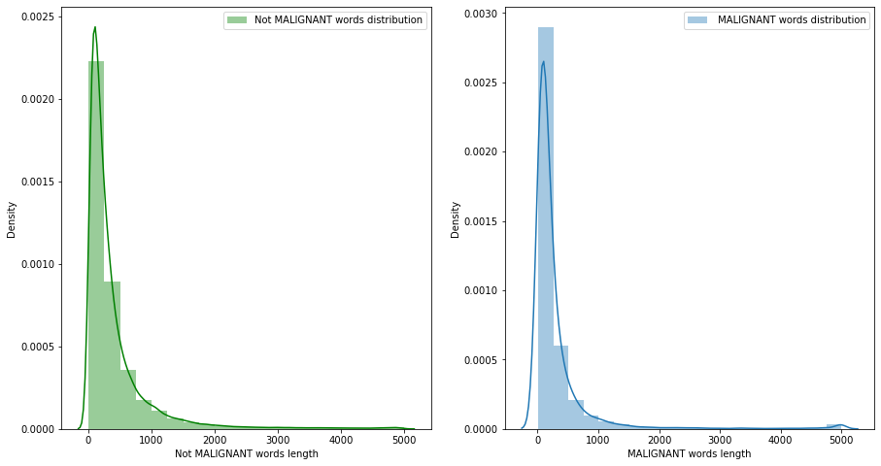
Not Malignant and Malignant comments with original comments

Slide 12
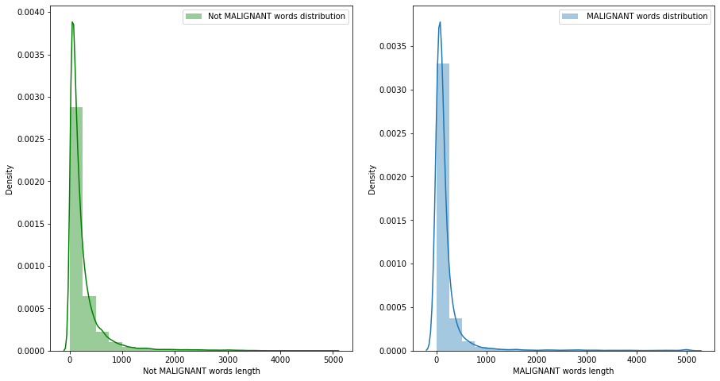
Not Malignant and Malignant comments with filtered comments

Slide 13
EXPERIMENTAL SET UP
Hardware requirements:-
1. Processor — core i5 and above
2. RAM — 8 GB or above
3. SSD— 250 GB or above
Software requirements:-
1. ANACONDA

Slide 14
DATA PREPROCESSING
The Complete data is divided in the ration of 70:30 for train and test respectively.
There is no null value present in the dataset and almost all the columns type is objective so we don’t need to check for outliers.
Once our data is ready, we’ll do further processing.
I have dropped only one column i.e. ID because it’s not useful for prediction.

Slide 15

EVALUTION PROCESS
Evaluation Matrices:
Accuracy - it determines how often a model predicts default and non default correctly.
Precision-it calculates whenever our models predicts it is default how often it is correct.
Recall- Recall regulate the actual default that the model is actually predict.
Precision Recall Curve - PRC will display the tradeoff between Precision and Recall threshold.

Slide 16
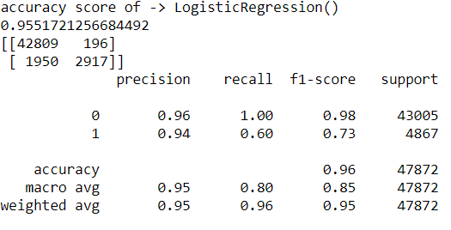
Logistic Regression

Slide 17
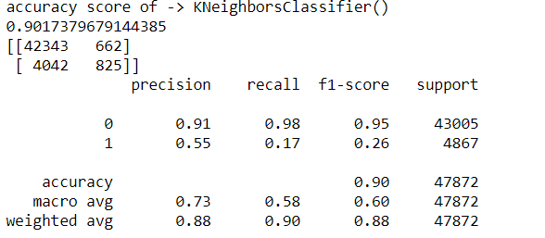
K-neighbors Classifier

Slide 18
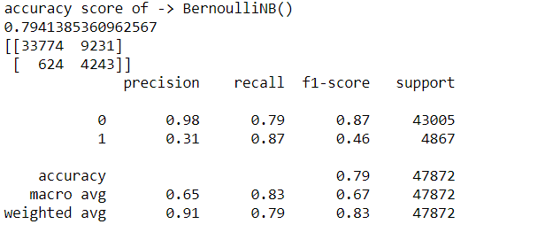
Bernoulli NB

Slide 19
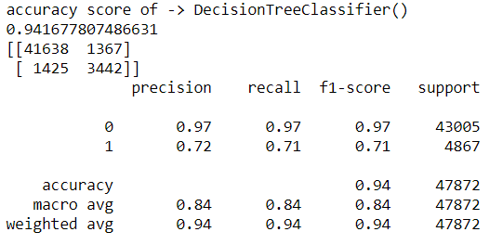
Decision Tree Classifier

Slide 20
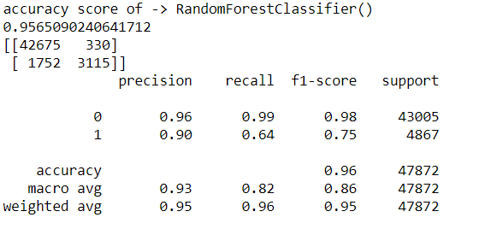
Random Forest Classifier

Slide 21
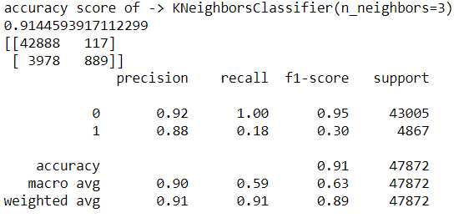
K neighbors Classifier (n_neighbors=3)

Slide 22
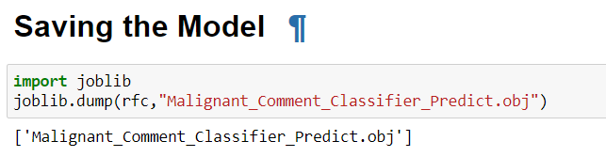
RESULT
From the details on the above solutions it is clearly understandable that we are getting best result with the help of Random Forest Classifier, so we save this model with the help of joblib Library.

Slide 23
CONCLUSION
As we know data is increasing in every second in our day today life. So more the data better the model.
Here we saw that harmful or toxic comments in the social media space have many negative impacts to society.
The ability to readily and accurately identify comments as toxic could provide many benefits while mitigating the harm.
we have seen the capability of readily available algorithms to be employed in such a way to address this challenge.
In our specific study, it was demonstrated that an Random Forest Classifier solution provides substantial improvement in classification versus any other algorithm.

Slide 24
Thank YOU !

